Slide 1
Impact Genome Registry Classification
DSC 672 - Data Science Capstone
Julia Aptekar, John Leniart, Arham Mehdi, Natalie Olechno
Notes:
Link to Presentation: https://youtu.be/3uM2UO9gDM8

Slide 2
Introduction
The Impact Genome Project maintains a registry with the verified outcomes of social programs
This is a centralized database where nonprofits can report their impact and outcomes for potential funders to see
Program outcomes are currently categorized manually
To improve efficiency, Impact Genome wants to use a classification model to predict the outcomes of each program
They created a model using Google’s Vertex AI platform
The accuracy of that model was around 52%
Notes:
Jack

Slide 3
Project Proposal
Our group set out to develop a new classification model that can outperform the Vertex AI model that is currently being used
As this project involves Natural Language Processing (NLP), our group decided to develop a BERT model
BERT is quickly becoming the industry standard for NLP tasks
We are aiming to achieve greater than 60% accuracy when predicting outcomes
Experiment with some different variations of BERT
Notes:
Jack

Slide 4
The Data
The dataset has six columns and 6,649 rows
Columns: Program Report ID, Program Description, Impact Area, Genome, Outcome, and Outcome ID
The data is hierarchical
12 unique values for impact area
50 unique values for genome
201 unique values for outcome
289 unique values for outcome ID
This is the target variable our model will be predicting
Notes:
Jack

Slide 5
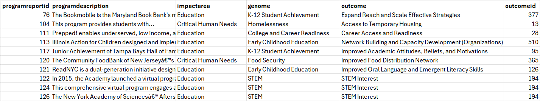
The Data
Notes:
Jack

Slide 6
Programs
Impact Area
Impact Area
Impact Area
Genome
Genome
Genome
Genome
Genome
Outcome
Outcome
Outcome
Outcome
Outcome
Outcome
Outcome
Notes:
Each combination of impact area + genome + outcome is assigned a unique outcome ID
Jack

Slide 7
Exploratory Data Analysis
Each member of our group worked on EDA individually
Here are some of the graphs and visualizations that were created

Slide 8
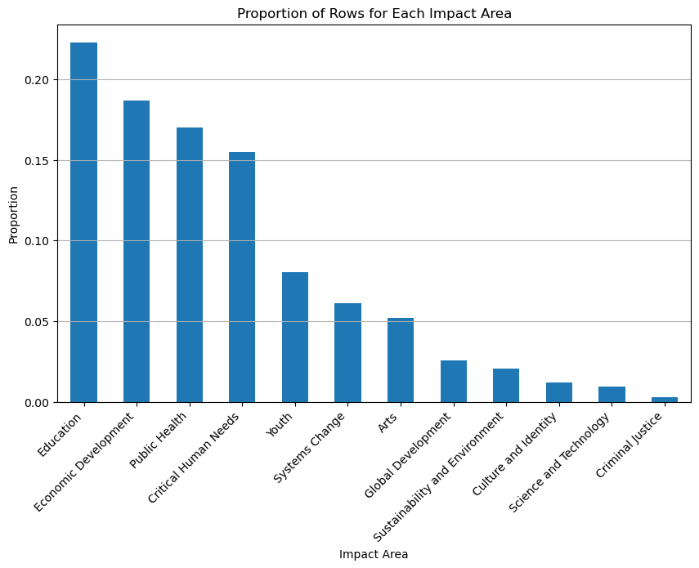
Notes:
Jack

Slide 9
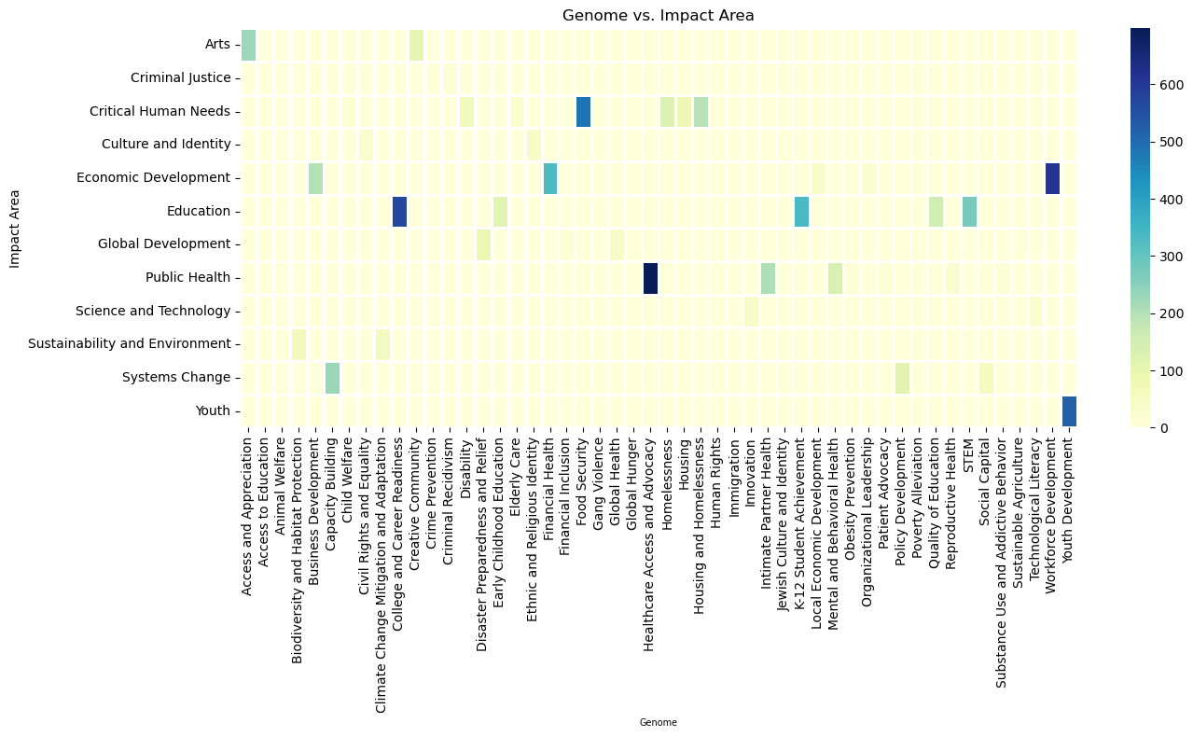

Slide 10
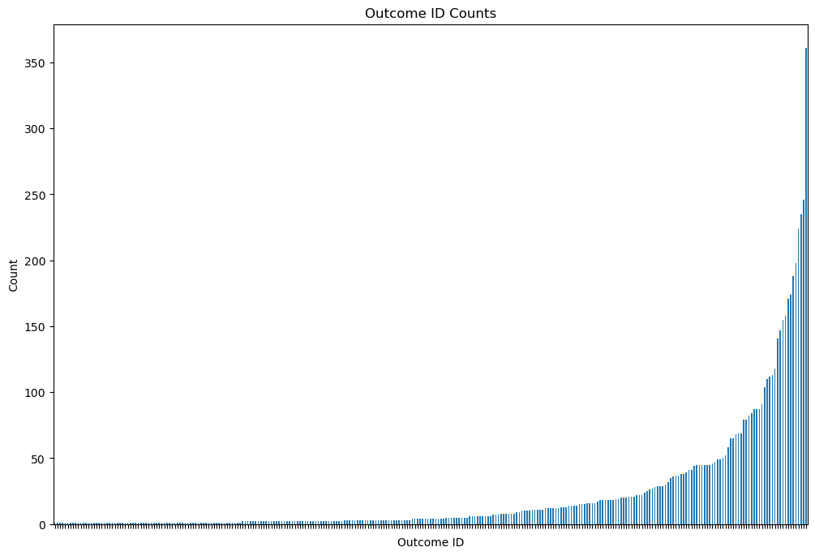

Slide 11
Synthetic Data
Our team was also provided with some synthetic data
Professor Hecktman’s team created the synthetic data using a Python script that leverages ChatGPT
Created to supplement the number of observations for the minority class outcomes
The synthetic dataset contains 4,409 rows and 5 columns
Does not include a column for program report ID
We plan to merge the original and synthetic datasets
This should help us train a more well-rounded classification model

Slide 12
Model Development - Logistic Regression
Used One Hot Encoding to encode the string values that will be used as input
Program Descriptions
Defined pipeline to reference the transformer and Logistic Regression model
Started with base parameters and then focussed on tuning
Grid Search with five-fold Cross Validation
Used to determine the best parameters for the pipeline and the LR model
Trained and tested the model using:
Only original data
Combination of original and synthetic data

Slide 13
Model Development - BERT 1
Hierarchical BERT Model Approach
Step 1: Predict Impact Area using Program Description
BERT-based classification
Step 2: Predict Genome using Program Description + Predicted Impact Area
Step 3: Predict Outcome ID using Program Description + Predicted Impact Area + Predicted Genome
Training Configuration
Train-Test Split: 80% Training, 20% Testing
Optimizer: AdamW, Learning Rate: 2e-5
Epochs: 4 for Impact Area, 5 for Genome, and 8 for Outcome ID
Loss Function: Cross-Entropy Loss (Class Weighted)
Data Augmentation: Synthetic data introduced for minority classes

Slide 14
Fine-Tuning and Optimization - BERT 1
Stratified Sampling
Maintained class distributions across train/test sets
Focal Loss
Addressed class imbalance by emphasizing difficult-to-classify examples
Curriculum Learning
Gradually increased weight for Outcome ID classification over training epochs
Hard Negative Mining
Prioritized challenging samples for better learning

Slide 15
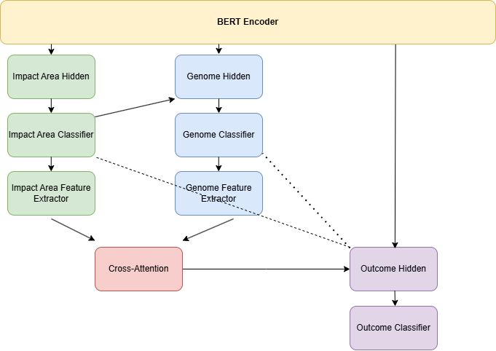
Model Architecture - BERT 2
Pre-trained BERT for language understanding
Hierarchical classification structure:
Impact Area
Genome
Outcome
Hierarchical conditioning: higher level predictions inform lower-level ones
Multi-head cross-attention layers capture complex relationships between categories
Notes:
Natalie - Hierarchical BERT model with advanced training techniques fine-tuned for managing loss.

Slide 16
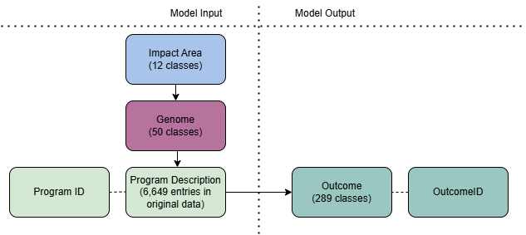
Optimization and Scheduling - BERT 2
Layered learning rate
Lower rates for BERT encoder
Intermediate rates for Impact Area and Genome
Highest rate for Outcome classification
ReduceLRONPlateau
Monitors Outcome F1 score and reduces learning rate after 2 epochs without improvement
Early stopping
Patience of 3 epochs
Notes:
Natalie

Slide 17
Fine-Tuning - BERT 2
Managing Loss
Focal loss - addresses class imbalance
Dynamically weights well-classified examples to prevent more common classes from dominating gradient updates
Uncertainty Weighting - balances relative importance of tasks
Uses log variances to balance the relative importance of Impact Area, Genome, and Outcome
Consistency Loss - enforces hierarchical relationships between tasks
Penalizes predictions that break hierarchy between Impact Area, Genome and Outcome
Notes:
Natalie

Slide 18
Fine-Tuning - BERT 2
Managing Training Process
Curriculum Learning - gradually increases importance of Outcome relative to Impact Area and Genome
Scales Outcome loss weight from 1.0 to 3.0 over first 5 epochs of training
Hard negative mining - focuses training on most challenging cases
Weighted sampler from subset of training data that prioritizes high loss instances
Recalculates every 2 epochs
Notes:
Natalie

Slide 19
Model Development - BERT 3
BERT Hierarchical Architecture
Pooled output from BERT passed into Impact classifier
Same pooled BERT embeddings passed into Genome classifier, independent prediction
Using the same pooled BERT embeddings, Outcome classifier separately predicts outcome ID
Training configuration
Data Augmentation: Synthetic data introduced for minority classes
Train-Test Split: 80% Train, 20% Test
Optimizer: AdamW, Learning Rate 2e-5, Epsilon 1e-8
Epochs: 10
Loss function: Focal Loss

Slide 20
Fine-Tuning and Optimization - BERT 3
Stratified Sampling
Manual split of the most minority classes
Level-specific Focal Loss Functions
γ = 2 for Impact Area and Genome, γ = 4 for Outcome
Dynamic Loss Weights
Adjusts the loss weight for each class based on epoch performance

Slide 21
Comparing Performance Across All Models
Performance Metrics | Logistic Regression | Base BERT (1 epoch, no hierarchy) | BERT Model 1 | BERT Model 2 | BERT Model 3
Impact Area Accuracy | N/A | N/A | 87.3% | 88.6% | 88.77%
Genome Accuracy | N/A | N/A | 86.3% | 83.8% | 83.81%
Outcome ID Accuracy | 38.55% | 23.4% | 66.3% | 66.6% | 66.4%
F1 Score | 0.413 | 0.11 | 0.70 | 0.70 | 0.67
Precision | 0.527 | 0.11 | 0.72 | 0.74 | 0.71
Recall | 0.386 | 0.17 | 0.73 | 0.71 | 0.67

Slide 22
Future Improvements
Generating additional synthetic data for outcomes with small number of program descriptions
Alternative Pre-trained models like RoBERTa, DeBERTa
Examine other classification techniques including logistic regression with fine-tuning
Notes:
Natalie

Slide 23
Thank You!
Julia Aptekar: japtekar@depaul.edu
John Leniart: jleniart@depaul.edu
Arham Mehdi: kmehdi@depaul.edu
Natalie Olechno: nolechno@depaul.edu

